Slide 1
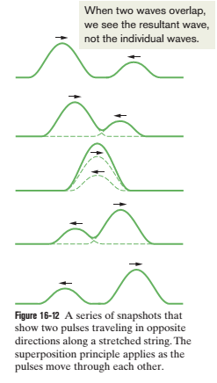
Lecture 19
The Principle of Superposition for Waves
Suppose that two waves travel simultaneously along the same stretched string. Let y₁(x, t) and y₂(x, t) be the displacements that the string would experience if each wave traveled alone.
The displacement of the string when the waves overlap is then the algebraic sum
y’(x, t) = y₁(x, t) + y₂(x, t)
Overlapping waves algebraically add to produce a resultant wave (or net wave)
Overlapping waves do not in any way alter the travel of each other.

Slide 2
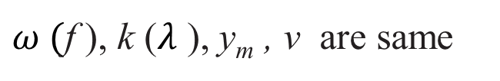
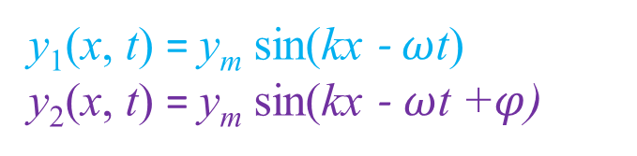

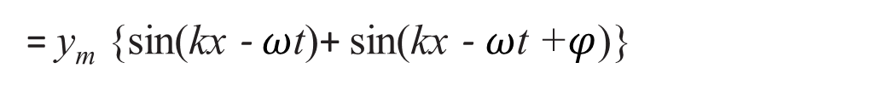
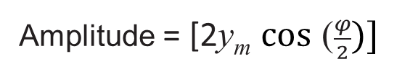
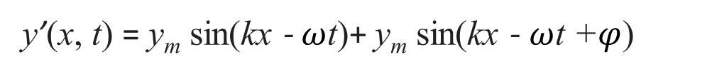
Interference of Waves
Suppose we send two sinusoidal waves of the same wavelength and amplitude in the same direction along a stretched string.
y₁(x, t) = y_{m} sin(kx - $ω$t) y₂(x, t) = y_{m} sin(kx - $ω$t +$φ$)
$ω ($f ), k ($λ$ ), y_{m} , v are same
Superposition principle,
y’(x, t) = y₁(x, t) + y₂(x, t)
y’(x, t) = y_{m} sin(kx - $ω$t)+ y_{m} sin(kx - $ω$t +$φ$)
= y_{m} {sin(kx - $ω$t)+ sin(kx - $ω$t +$φ$)}
= y_{m} {2 sin ( $\frac{kx − ωt+ kx − ωt +φ}{2})\text{cos}\text{ (} \frac{kx − ωt− kx+ ωt − φ}{2})\}$
= 2y_{m} sin {$\frac{2( kx − ωt) +φ}{2}\}\text{cos}\text{ (}\frac{− φ}{2})$
= 2y_{m} sin {$\left( kx − ωt\right)+ \frac{φ}{2}\} \text{cos}\text{ (}\frac{φ}{2})$
y’(x, t) = [2y_{m} $\text{cos}\text{ (}\frac{φ}{2})]$ sin ($kx − ωt+\frac{φ}{2}) [traveling waves]$
Resultant displacement = y’(x, t)
Amplitude = [2y_{m} $\text{cos}\text{ (}\frac{φ}{2})]$
Oscillating term = sin ($kx − ωt+\frac{φ}{2})$

Slide 3

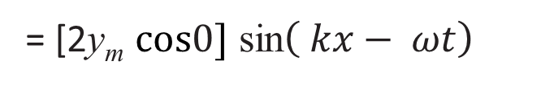
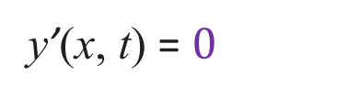
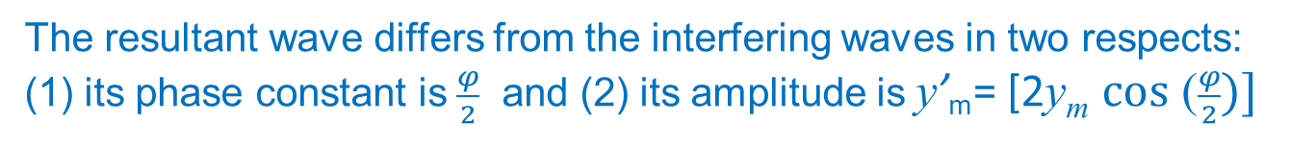
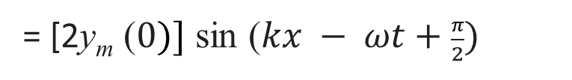
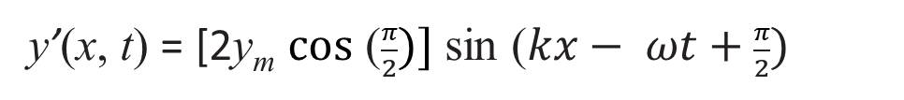
If two sinusoidal waves of the same amplitude and wavelength travel in the same direction along a stretched string, they interfere to produce a resultant sinusoidal wave traveling in that direction.
Interfering waves: y₁(x, t) = y_{m} sin(kx - $ω$t) y₂(x, t) = y_{m} sin(kx - $ω$t +$φ$)
Resultant wave : y’(x, t) = [2y_{m} $\text{cos}\text{ (}\frac{φ}{2})]$ sin ($kx − ωt+\frac{φ}{2})$
The resultant wave differs from the interfering waves in two respects: (1) its phase constant is $\frac{φ}{2}$ and (2) its amplitude is y’_{m}= [2y_{m} $\text{cos}\text{ (}\frac{φ}{2})]$
(1) If $φ$= $0$rad (0⁰): fully constructive interference
y’(x, t) = [2y_{m} $\text{cos}\text{ (}\frac{0}{2})]$ $\text{sin}\text{ (}kx − ωt+\frac{0}{2}) \}$
= [2y_{m} $\text{cos}0]$ sin$\left( kx− ωt\right)$
y’(x, t) = 2y_{m} sin$\left(kx− ωt\right)$ [greatest amplitude]
(2) If $φ$= $π$ rad (180⁰): fully destructive interference
y’(x, t) = [2y_{m} $\text{cos}\text{ (}\frac{π}{2})]$ sin ($kx− ωt+\frac{π}{2})$
= [2y_{m} $\text{(}0)]$ sin ($kx − ωt+\frac{π}{2})$
y’(x, t) = $0$

Slide 4
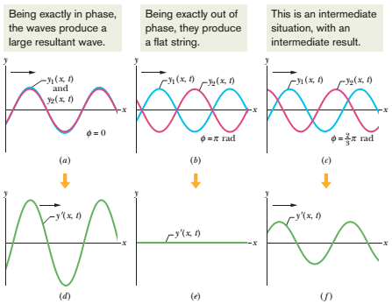
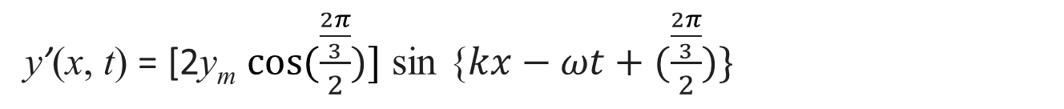
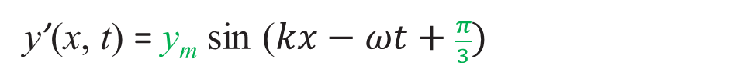
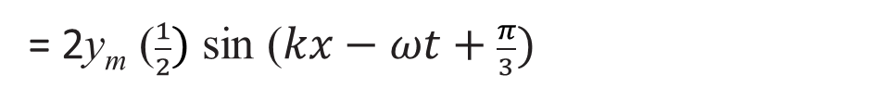
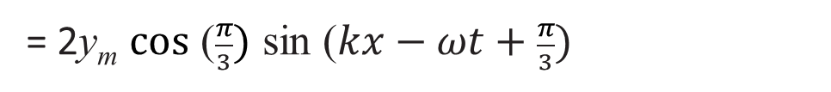
(3) If $φ$ = $\frac{2π}{3}$ rad (120⁰): intermediate interference
y’(x, t) = [2y_{m} $\text{cos}(\frac{\frac{2π}{3}}{2})]$ sin {$kx−ωt+(\frac{\frac{2π}{3}}{2})\}$
= 2y_{m} $\text{cos}\text{ (}\frac{π}{3})$ sin ($kx−ωt+\frac{π}{3})$
= 2y_{m} $\text{(}\frac{1}{2})$ sin ($kx−ωt+\frac{π}{3})$
y’(x, t) = y_{m} sin ($kx−ωt+\frac{π}{3})$

Slide 5
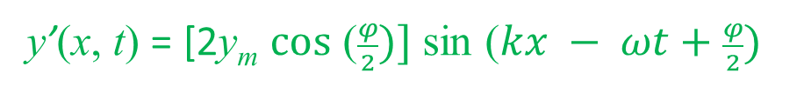
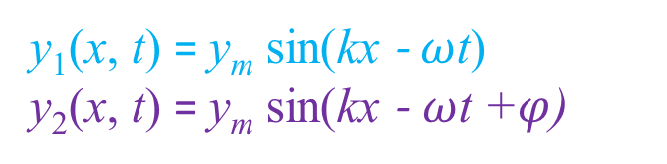


32. What phase difference between two identical traveling waves, moving in the same direction along a stretched string, results in the combined wave having an amplitude 1.50 times that of the common amplitude of the two combining waves? Express your answer in (a) degrees, (b) radians, and (c) wavelengths.
y₁(x, t) = y_{m} sin(kx - $ω$t) y₂(x, t) = y_{m} sin(kx - $ω$t +$φ$)
Superposition principle,
y’(x, t) = y₁(x, t) + y₂(x, t)
y’(x, t) = y_{m} sin(kx - $ω$t)+ y_{m} sin(kx - $ω$t +$φ$)
= y_{m} {sin(kx - $ω$t)+ sin(kx - $ω$t +$φ$)}
= y_{m} {2 sin ( $\frac{kx − ωt+ kx − ωt +φ}{2}) \text{cos}\text{ (} \frac{kx − ωt− kx+ ωt − φ}{2})\}$
= 2y_{m} sin {$\frac{2( kx − ωt) +φ}{2}\} \text{cos}\text{ (} \frac{kx − ωt− kx+ ωt − φ}{2})$
= 2y_{m} sin {$\left( kx − ωt\right)+ \frac{φ}{2}\} \text{cos}\text{ (}\frac{− φ}{2})$
y’(x, t) = [2y_{m} $\text{cos}\text{ (}\frac{φ}{2})]$ sin ($kx − ωt+\frac{φ}{2})$
(a) [2y_{m} $\text{cos}\text{ (}\frac{φ}{2})]=1.50 \text{y}\text{m}$
$$\text{cos}\text{ (}\frac{φ}{2})=1.50/2$$

Slide 6











$$\text{cos}\text{ (}\frac{φ}{2})=0.75$$
$$\frac{φ}{2}=\text{cos}−1 (0.750)$$
$$\frac{φ}{2}=\text{ 41.41}$$
$$φ=\text{ 2(41.41)}$$
$$φ=\text{ 82.82}\text{0 }\text{Ans}\text{.}$$
(b) $\frac{φ}{2}=\text{cos}−1 (0.75 rad)$
$$\frac{φ}{2}=0.7227 rad$$
$$φ=\text{ 1.45 }\text{rad} \text{Ans}\text{.}$$
$$\left(c\right) 2π rad= λ$$
$$1 rad=(\frac{λ}{2π})$$
$1.45 rad=1.45\left(\frac{λ}{2π}\right)=0.23λ$ Ans.

Slide 7
Additional problem:
Sample problem 16.04, page: 461

